Slide 1
The Basics of Copyright William Cross Austin, Texas June 21, 2013
©
INTELLECTUAL PROPERTY:
ACRL Scholarly Communications Roadshow

Slide 2
What is Copyright?
Copyright is a bundle of rights to:
Make copies
Distribute the work
Prepare derivative works
Publicly perform or display the work
License any of the above to third parties

Slide 3
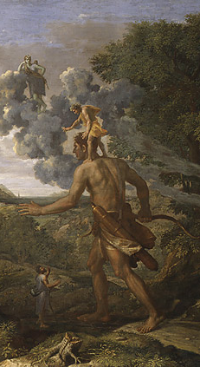
Who is Copyright For?
Constitution:
“Promote the progress of science”
Incentivizing creativity

Slide 4
How Do We Get Copyright?
Copyright exists from the moment of creation
In original works fixed in tangible form
Lasts for the life of the author plus 70 years
No need to use ©, no “magic words”
Copyright just happens

Slide 5
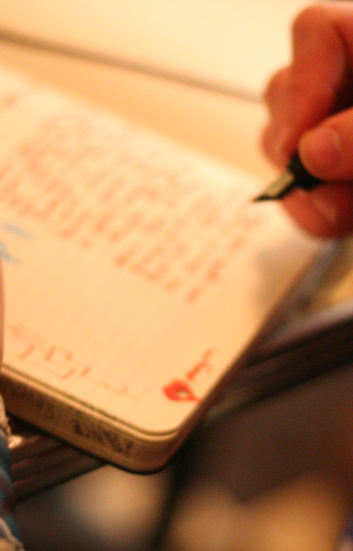
Who is the Copyright Holder?
The creator is usually the initial copyright holder
If two or more people jointly create a work, they are joint copyright holders, with equal rights
With some exceptions, work created as a part of a person's employment is a “work made for hire” and the copyright belongs to the employer
Copyright “follows the pen”

Slide 6
What Copyright Protects
NOT PROTECTED
Ideas
Facts
Titles
Data
Methods (patent)
PROTECTED
Writing
Choreography
Music
Visual art
Film
Architectural works

Slide 7
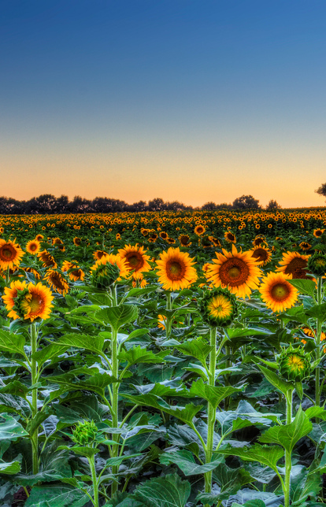
Free as Air – The Public Domain
Works published before 1923
Works published without notice prior to 1989
Works not renewed prior to 1963
Works of the federal gov’t
Titles, short phrases & facts
Ideas

Slide 8
Fair Use
FOUR FACTORS
ONE QUESTION: Transformation
What are you doing?
What are you using?
How much are you using?
Is your work a substitute?
“Are you adding something new, or just free riding on someone else’s work?”

Slide 9
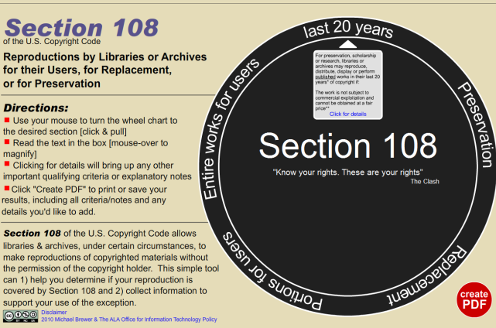
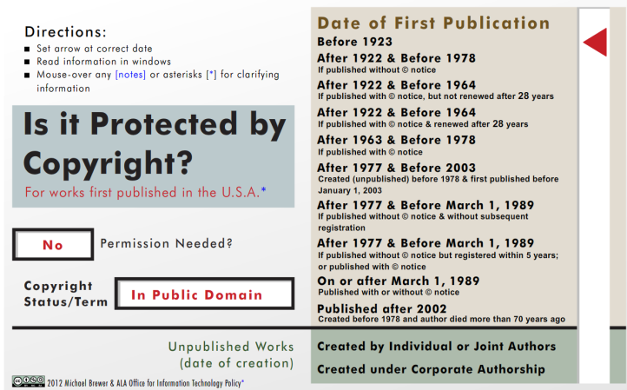
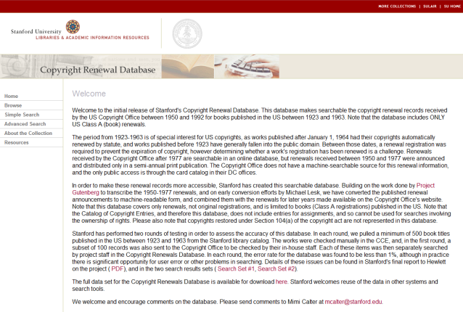
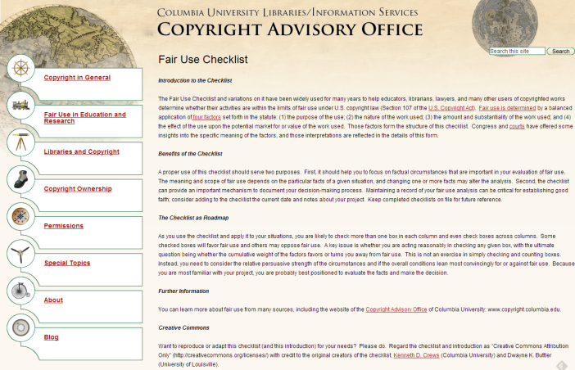
Tools for Evaluating Copyright

Slide 10
Managing Our Rights

Slide 11
Giving Away Copyright?!
Copyright can only be transferred (“assigned”) in writing
Licensing allows specific rights to be retained:
Authors keep copyright and license other rights (e.g., first publication)
Publishers take copyright and license rights back (e.g., reproduction, derivatives)
Addenda can be added to publication agreements to negotiate rights retention

Slide 12
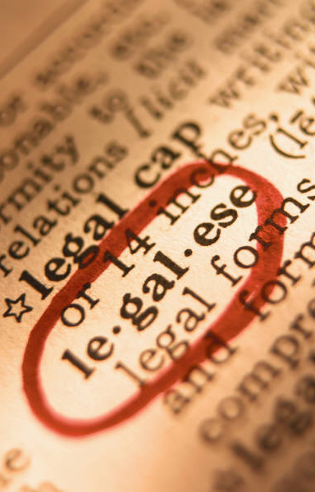
Licenses and Copyright
Licenses are contracts that allow others to exercise some right that the licensor owns
A non-exclusive license can be transferred verbally (writing is better)
May carry conditions and limitations
It can LOOK like copyright transfer, especially if exclusive

Slide 13
Bundled vs. Unbundled
RIGHTS PUBLISHERS WANT
RIGHTS PUBLISHERS NEED
Reproduction
Distribution
Derivatives
Pretty much all of them
Right of First Publication
. . . that’s really all
Other issues can be managed with licenses

Slide 14
Why is Reuse Important?
By the Author
By Others
Distribution to colleagues
Teaching
Web access
Conference presentation
Republication
OA, freely accessible
. . . and possibly more
If Creative Commons licensed, then license defines reuse
If published traditionally, only fair use

Slide 15
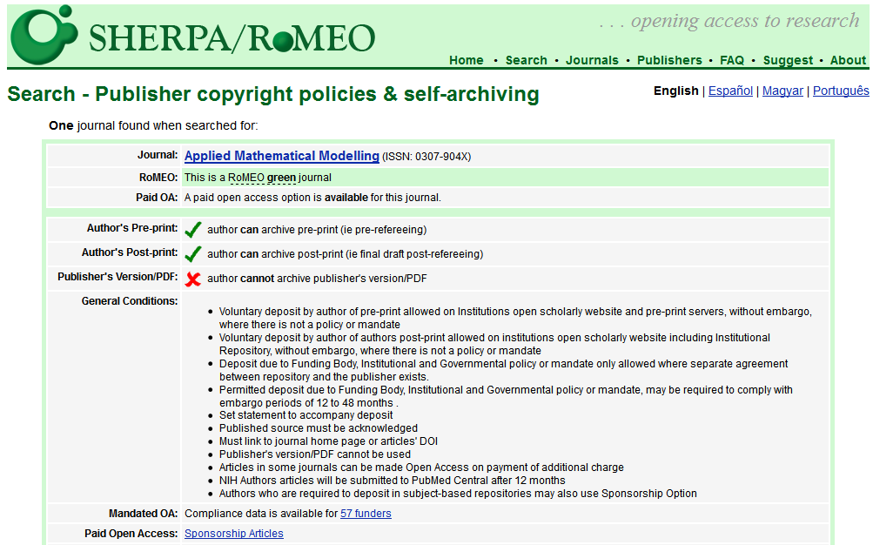

Slide 16
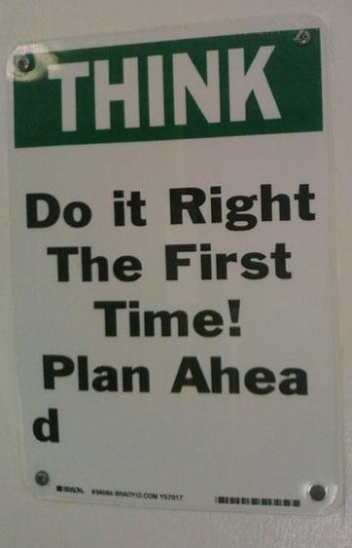
It’s Negotiable
If you don’t ask, you don’t get
Even if you don’t succeed, it is useful to ask
Think about what you need
Read and save the agreement
Consider addenda (and learn from them!)
Work with your editor or publisher
Know what you want to accomplish!

Slide 17
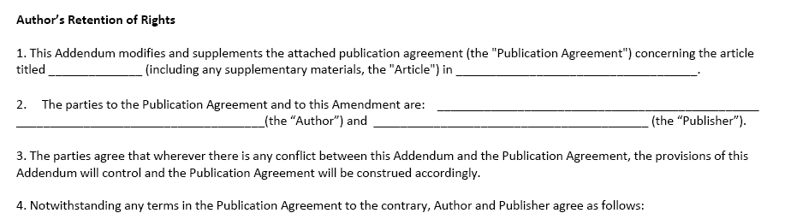
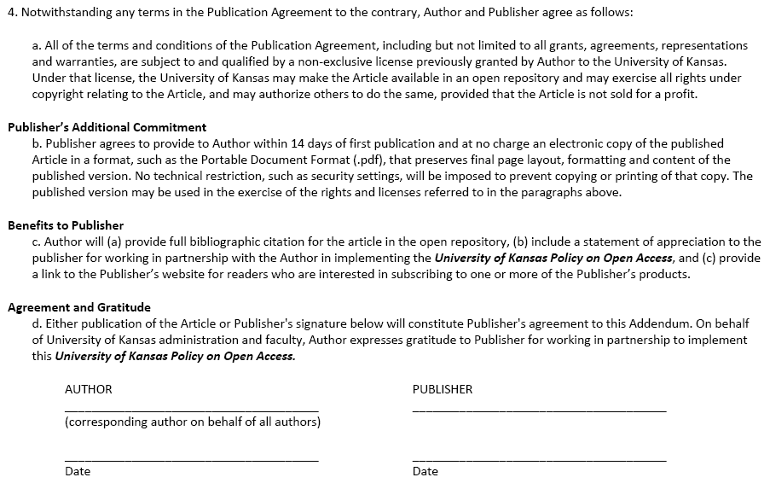
Addendum to Publication Agreement

Slide 18
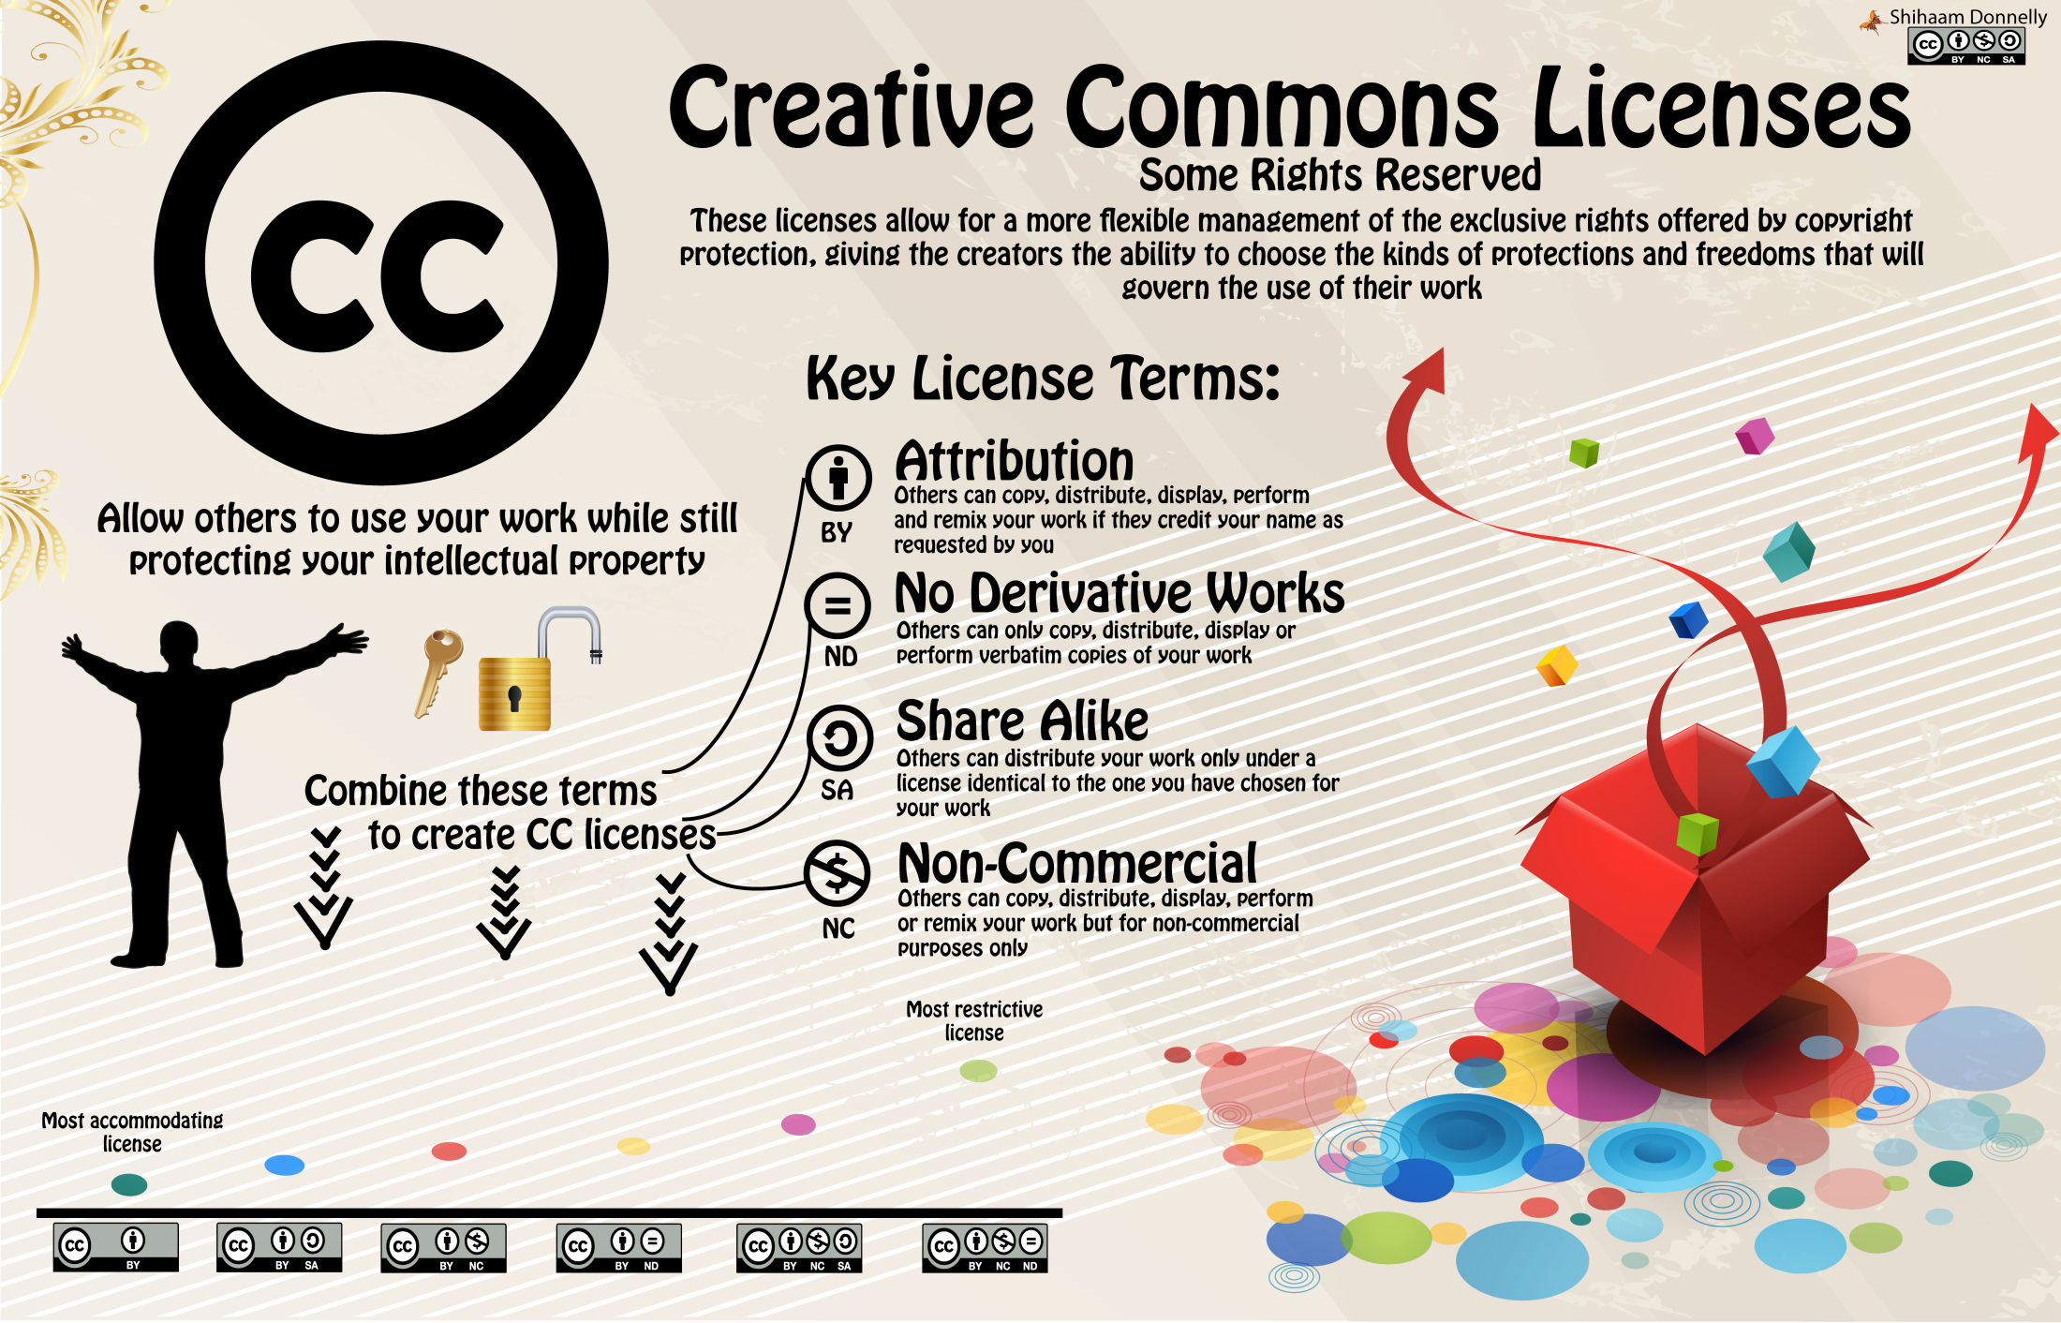

Slide 19
Take Home Points
We all own copyright automatically until we sign it away
Try not to give away more than you need to
Think ahead to how you might want to use your work
CC licenses, addenda, and negotiation are simple steps that don’t negate peer-review

Slide 20
“Fish Bowl” Discussion

Slide 21
Scenarios for discussion
A PI is listed as a contributing author, even though her direct contributions came through lab research, not writing
A graduate student wishes to publish several chapters from her thesis, which will be archived in the university’s ETD collection, as articles
A faculty member has created a website from class work and includes material from former students

Slide 22
Further scenarios for discussion
Who owns online course materials? What about online syllabi?
Should we treat OA differently for creative writing and music composition faculty and students?
How should we plan for and negotiate embargoes for OA dissertations?

Slide 23
Rights Agreement Exercise

Slide 24
Publication Agreements
Indicators of author friendly or unfriendly contracts.
The author, hereinafter referred to as “chopped liver”
Copyright transfer v. “exclusive” or “non-exclusive” licenses
What versions of the article can the author do what with?
classroom use, redistribution, website posting, repository posting, giving talks at conferences with the work
Embargoes (delayed release periods), and conditions?

Slide 25
Questions?

Slide 26

This work was created by Molly Keener for the 14th ACRL National Conference, Scholarly Communication 101 workshop, and last updated by Will Cross, Molly Keener, and Kevin Smith in May 2013.
This work is licensed under a Creative Commons Attribution Non-Commercial Share Alike 3.0 United States license: http://creativecommons.org/licenses/by-nc-sa/3.0/.

